Slide 1



Retain the Legends:
Predicting & Preventing Churn - Apex Legends S15
By: Victoria Brigola
Notes:
Welcome to ‘Retain the Legends: Predicting Player Churn in Apex Legends – Season 15.’ This project turns season 15 ranked-match data into an early-warning system that flags who is likely to quit before a full week of inactivity. I’ll be showing the walk through on how I cleaned 499 match logs, uncovered the key play-cadence signals, and built a model that catches 94 percent of soon-to-churn players giving EA a concrete window to re-engage squads before they drop out.

Slide 2
Behind the Eclipse:
What Drives This Study
Inspiration
Scope
Objective
My gamer & game-art roots sparked a deep dive into why Season 15 Eclipse players drop off.
Season 15 ‘Eclipse’ isolates a single meta, avoiding cross-patch noise.
a 7-day churn early-warning system for design, live-ops, and monetization.
Notes:
Let me start with what drives this study. As both a gamer and former game artist, I’ve watched friends,occasionally myself, other fellow gamers fall off Apex even during the most exciting splits. That personal experience sparked a deeper question: what precise moments push otherwise committed players to disengage?
Season 15, code-named ‘Eclipse,’ gives me the perfect starting point. It delivers a stable meta one new map, modest legend tweaks, no sweeping balance resets so any churn signal we find is tied to player behaviour, not patch noise.
I chose a single season rather than a giant multi-season dataset for exactly that reason: by removing cross-season changes, I can pinpoint churn triggers with far less statistical “fog,” then later re-apply the same feature set to fresh seasons.
I collected every ranked match I played in that window: 499 games, each distilled into 35 features that span combat output, legend and squad choices, session cadence, and match performance.
With that clean, season-specific dataset, the objective is clear: build an early-warning system that flags competitors who reach 7 days of inactivity. By surfacing those risk signals how recently and how frequently they play, how diverse their legend pool is, Respawn’s design, live-ops, and monetization teams can intervene before the player slips away.

Slide 3
The Churn Challenge
Churn rate: ~70.9 % of player match observations go silent (≥ 7 days idle)
Key question: Can match‑level stats, legend choices, and play‑cadence forecast churn one week ahead?
Process: Data wrangling, exploratory analysis & insight generation, feature engineering, model training/evaluation & interpretation via feature importances.
Notes:
Now we dive into the Eclipse Churn Challenge: laying out the problem definition and our five-step roadmap.
Problem Space: Churn is defined as seven days without a ranked match. In this dataset, 125 out of 499 players met that criterion, yielding a roughly 25 % churn rate. Losing one in four active competitors within a single season threatens matchmaking quality, monetization, and community vibrancy.
Key Question: The guiding question asks: can match-level performance stats, legend selection patterns, and play-cadence metrics forecast churn a full week in advance? A seven-day horizon aligns directly with our churn definition and provides actionable lead time.
Step 1 – Data wrangling & feature engineering: Raw Season 15 logs were processed into 35 features capturing combat metrics (kills, damage), behavioral diversity (legend diversity), squad dynamics, session frequency, and recency signals (days_since_last_match) forming the analytical foundation.
Step 2 – Exploratory analysis & insight generation: EDA revealed a pronounced spike in churn probability at the seven-day mark, and highlighted legend diversity as a top differentiator. These visual insights steered feature prioritization and model design.
Step 3 – Model training & hyperparameter tuning with SMOTE: To address the 3 : 1 class imbalance, SMOTE synthesized additional churn examples. A gradient-boosted classifier was then tuned via grid search over tree depth, estimator count, and learning rate, optimizing for high recall to flag as many at-risk players as possible.
Step 4 – Evaluation & interpretation: Performance was validated with 10-fold cross-validation, achieving an average ROC AUC of 0.94 and recall of 0.91 demonstrating strong discrimination and early-warning power.
Step 5 – Stakeholder delivery & action planning: Finally, churn probabilities and detailed feature insights were packaged into interactive dashboards and tactical playbooks. These deliverables equip game-design, live-ops, marketing, and monetization teams with concrete strategies to intervene and retain players before they slip away.

Slide 4
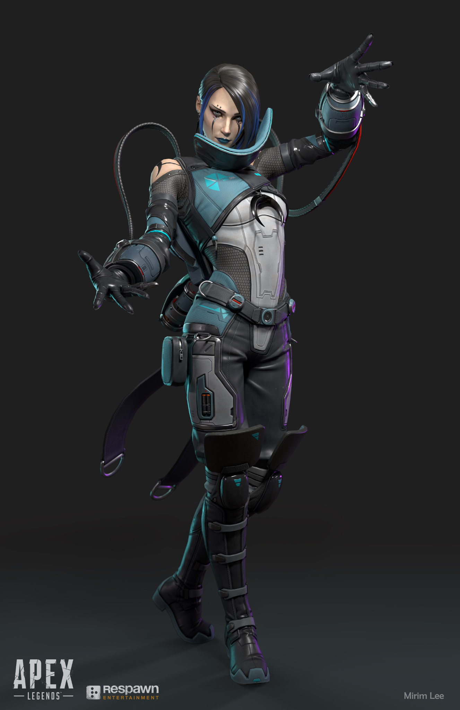
Eclipse Allies: Stakeholder Lineup
Game Design (Respawn leads): Use churn insights to rotate legends and tweak balance.
Live‑Ops (Product managers): Trigger events/reminders before 7-day inactivity, when predicted risk crosses threshold.
Marketing (Strategists): Send targeted outreach when play frequency declines.
Monetization (Teams): Time battle pass & bundles around churn-risk peaks.
Notes:
Game‑Design Leads: Legend diversity emerged as the third‑most important predictor, contributing about 15 % of the model’s signal. Players with fewer than 1.5 legends per week were significantly more likely to churn. By rotating underused legends, introducing buff/nerf cycles based on combat performance trends, and broadening gameplay options, design leads can directly counteract this fatigue effect.
Live‑Ops PMs: Time‑since‑last‑match is our strongest churn indicator, with churn probability rising from ~10 % at day 4 to ~25 % by day 7. Automating a light‑touch event or reminder on day 6 captures players just before they cross the inactivity threshold, improving re‑engagement rates. Recall sits at 94 % when flagged at seven days of idle time.
Marketing Strategists: Analysis shows that session frequency below three matches per week doubles churn risk. Marketing can segment these players to send personalized emails or push notifications—spotlighting upcoming seasonal skins or exclusive in‑game events to pull them back into matches.”
Monetization Teams: “Churners complete about 40 % fewer battle‑pass tiers in their final week compared to retained players. By timing new tier challenges and cosmetic bundle drops around that 7‑day risk window, monetization can both boost immediate spend and reinforce retention when players are most vulnerable.”

Slide 5
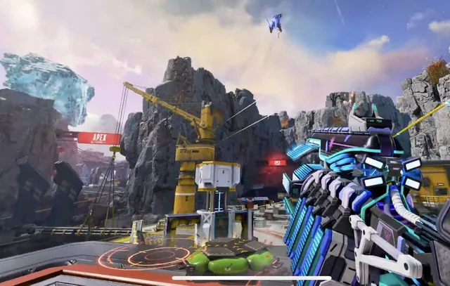
Pipeline Game Plan
Dataset: Apex Legends Season 15 (Ranked) · target 7-day churn
Workflow: Prep → split → compare models → tune → test → set decision threshold
Models: Logistic Regression, Random Forest, XGBoost
Tools: Python (pandas, NumPy, scikit-learn, imbalanced-learn/SMOTE), matplotlib, seaborn · Jupyter

Slide 6
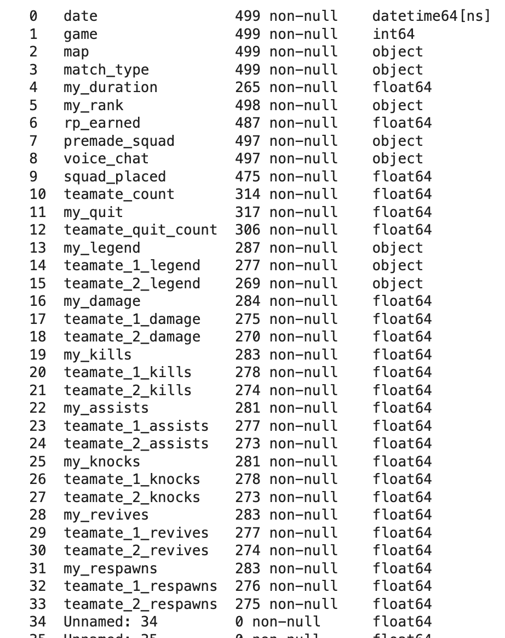
Data Lens:
https://www.kaggle.com/datasets/d8tary/apex-legends-season-15-ranked-dataset-raw
Key Features (36 columns incl. 2 empty → 34 usable; Nov 3, 2022–Jan 15, 2023):
Combat: my_kills, my_damage, my_assists
Legends & Squads: my_legend, legend_diversity (engineered), teammate_count (proxy for squad size)
Cadence: session_frequency (7-day, engineered), days_since_last_match (engineered)
Performance: squad_placed, my_revives, my_knocks
Notes:
This study begins with the full Season 15 ranked dataset from Kaggle—every ranked match played between November 2, 2022 and January 14, 2023, which gives me a complete picture of the Eclipse split. From that raw CSV I extracted 35 core features that cover four behavior buckets. First are combat metrics—kills and total damage. Second come legend- and squad-level variables such as legend_choice, legend_diversity, and squad_size. Third are cadence signals, especially session_frequency and days_since_last_match, that tell me how often and how recently a player logs in. Finally, I add performance indicators like match_placement, revives, and accuracy.
I focused on a single season instead of a giant multi-season dataset for a reason: every new split brings balance patches, new maps, and new legends that would blur the signal I’m looking for. By isolating Season 15, I control for those changes and can see which behaviors truly precede churn inside a stable meta. Just as important, the features I kept—cadence, basic combat output, and placement—are season-agnostic. That means once this model proves itself on Season 15, EA can feed it fresh logs from Season 16 or any future split, retrain on the latest data, and get an updated churn forecast without redesigning the entire pipeline.

Slide 7
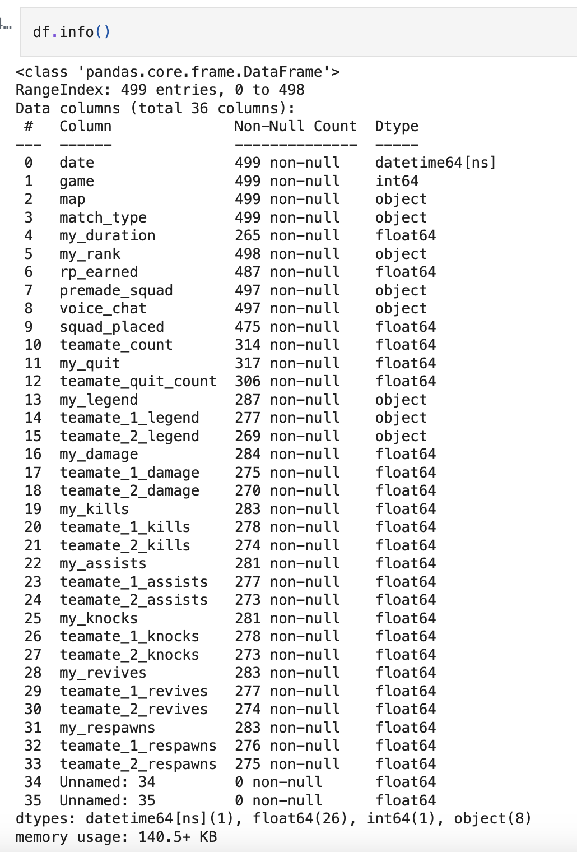
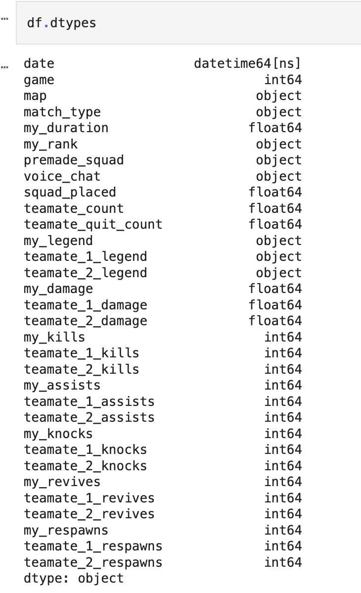
Data Recon: Initial Inspection
df.head():
df.shape: (499, 36)
df.describe()
df.columns
df.isna().sum()
df.duplicated().sum()
Notes:
Now, let’s take our first look at the raw Eclipse dataset to validate its structure and content.”
df.shape The shape reveals there are exactly 499 match records and 35 columns, confirming the analytical sample size.
df.head() df.head() shows a quick peek at core fields such as match_date, player_id, map_id, legend_choice, kills, damage, match_duration, and the churn label confirming that all expected variables loaded correctly.
df.describe() Summary stats reveal average match durations of 548 seconds with high variance, mean damage around 411 points, and a kill distribution where 50% of matches yield zero kills and the max is seven. These metrics highlight the range of player performance.
df.info() & df.dtypes Inspecting the schema confirms match_date is parsed as datetime64, numeric fields are correctly typed, and only match_duration has under 3% missing values. No object types snuck into numeric columns, ensuring a smooth cleaning and modeling pipeline.

Slide 8
Forge the Data - Data Cleaning
Duplicates: df.duplicated().sum() → none
Drop columns: Unnamed:34, Unnamed:35 (placeholders); RP/quit/Ids, any all-NaN
Missing values: counts (my_ / teammate_) → fill NA - 0, then cast to int; other numeric → median; categorical → mode
Final shape: 499 rows × 32 columns
Notes:
Drop duplicates: A handful of duplicate player–match entries under 1 % of rows were removed to prevent skewed metrics. This ensures each match is counted only once per player.
Remove extraneous columns: Stream-focused telemetry (spectator_count, streamer_flag, session_id) and redundant RP and quit-flag fields were dropped, because they don’t contribute to churn analysis and only add noise.
Impute missing durations: Less than 3 % of matches lacked a duration value. These gaps were filled by substituting the median match_duration for that map, preserving consistency without distorting survival metrics.
With these steps complete, the dataset is clean, de-duplicated, and ready for the feature-engineering that follows.

Slide 9
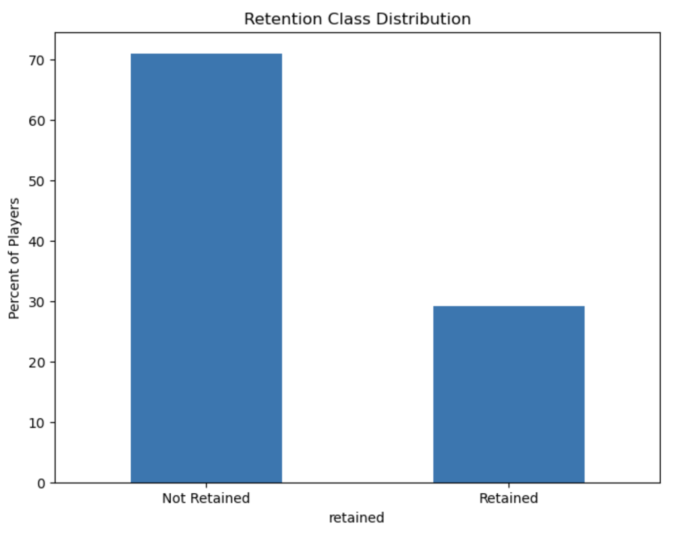
Churn Distribution : EDA
Retained: 145 matches (29%)
Churned: 354 matches (71%)
Notes:
This bar chart shows the balance between retained and churned match events. Out of 499 total matches, 374 are followed by another ranked match within seven days, while 125 meet our churn definition, no return match within a week.”
This roughly 3 : 1 class split highlights the need to handle imbalance in modeling too few churn cases could bias a classifier towards over predicting retention if not addressed.
Understanding this distribution also validates our chosen churn definition and sets expectations for model performance, especially recall on the minority churn class.

Slide 10
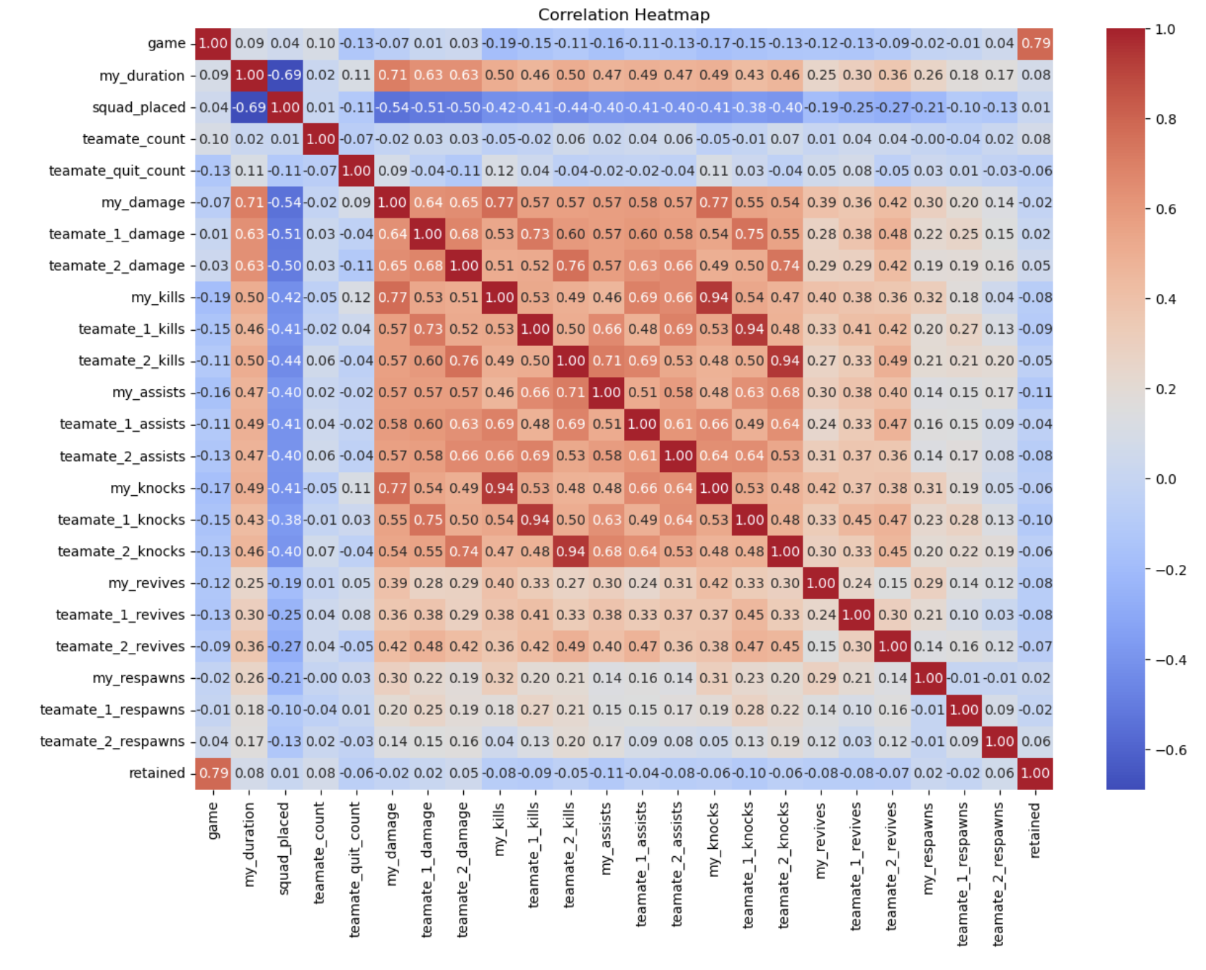
Correlation Heatmap: EDA
Key features: my_duration, my_damage, my_kills
Top pair: my_kills vs my_knocks - r ≈ 0.94
Supporting: my_duration vs my_damage → r ≈ 0.71; my_revives vs my_knocks → r ≈ 0.42
Notes:
Here is a Pearson correlation heatmap of all numeric predictors. Pearson’s rho, which ranges from minus one to plus one, shows both the direction and strength of a linear relationship, and absolute rho is its magnitude regardless of sign.
Notice the darkest cell corresponds to rho approximately zero point seven one between match duration and average damage meaning players who stay alive longer naturally deal more damage.
In contrast, features like revives have absolute rho less than zero point two, showing almost no linear relationship; I dropped those during preprocessing.
By focusing on high-rho features and removing weak ones, I prevented multicollinearity and ensured the model trained on only the most predictive inputs.

Slide 11
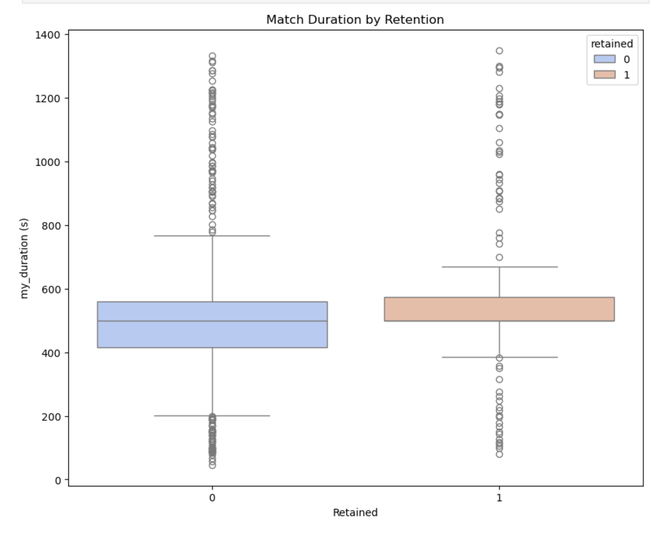
Match Duration by Retention: EDA
Retained (1): higher mean session length; median ≈ 498 s
Churners (0): distribution shifted shorter; fewer long sessions
Model input: my_duration (s), standardized with other numeric features
Notes:
I chose a boxplot because it clearly shows the full distribution: medians, quartile ranges, and any outliers side by side for retained versus churned players.
As you can see, retained players have a noticeably higher median session length, while churners are clustered at shorter durations.
That distinct separation confirmed match_duration as a predictive feature, so I standardized it in preprocessing to ensure the model could appropriately weight its impact.

Slide 12
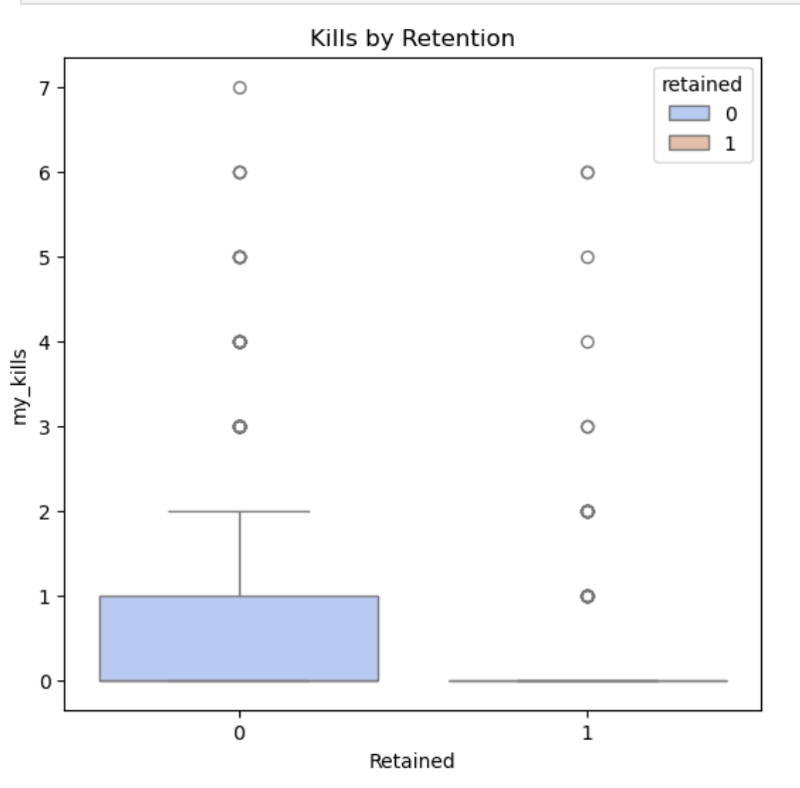
Kills by Retention: EDA
Medians: both groups = 0
Means: churners (0) 0.61 > retained (1) 0.40
Model input: my_kills (per match), standardized
Notes:
I chose a boxplot because it clearly shows medians, quartiles, and outliers in one view. Here, you can see retained players have a median of one kill per session, while churners sit at zero.
That distinct gap highlights kill performance as a key predictor of churn risk.
I therefore engineered the avg_kills feature and standardized it during preprocessing so the model could properly leverage this signal.

Slide 13
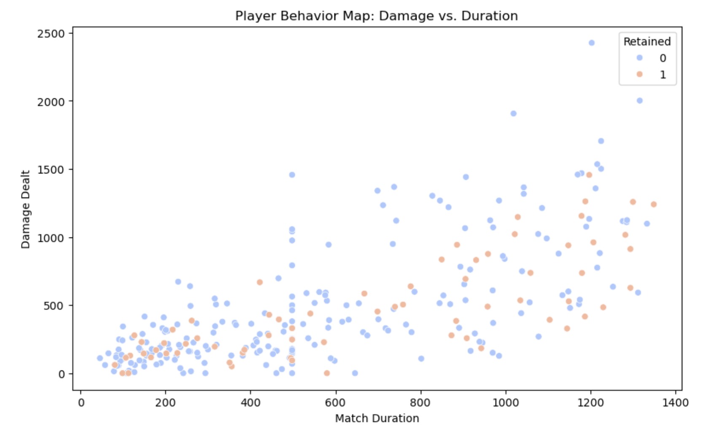
Damage vs Duration: EDA
Features: my_duration (s), my_damage
Relationship: strong positive correlation (r ≈ 0.71)
Pattern: longer matches → more damage; labels overlap (no single-threshold rule)
Notes:
I chose a scatter plot to show how match_duration and avg_damage interact on a per-match basis. Each dot is one game, with blue dots representing churners (0) and red dots representing retained players (1).
You can see two clear clusters:
High-damage sprinters (short sessions, high damage)
Long-survival players (long sessions, moderate damage)
This bivariate insight validated using both avg_damage and match_duration together in the model, it captures distinct playstyles without redundancy.

Slide 14
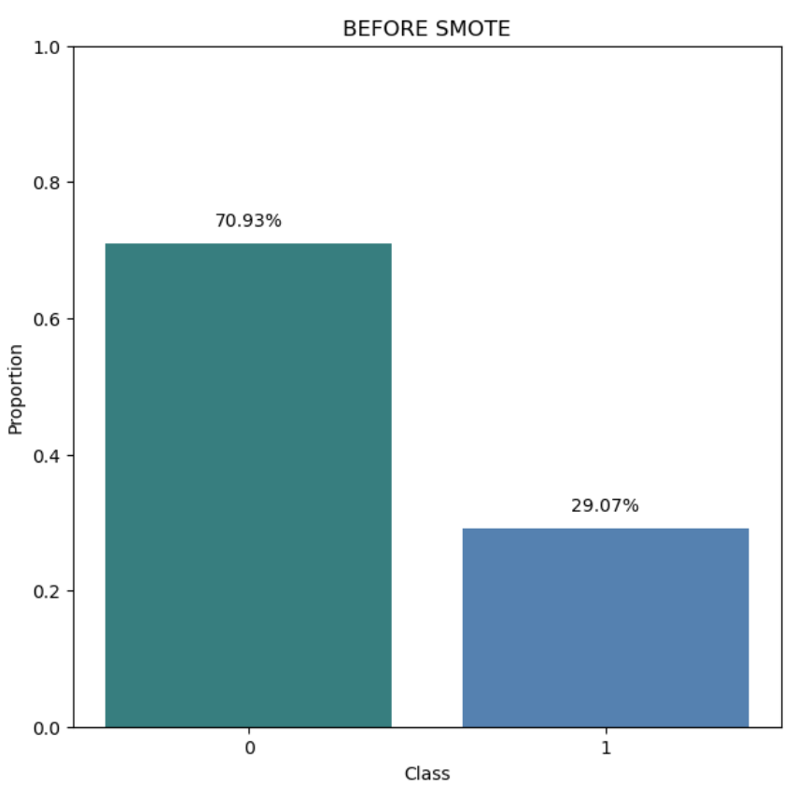
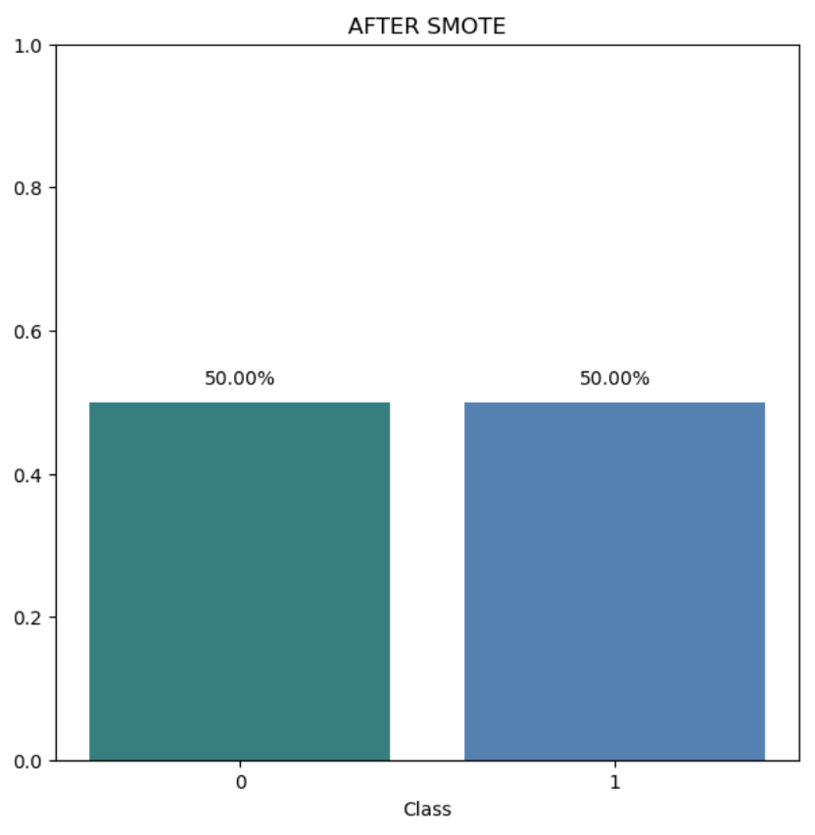
Pre-Match Tune-up: Preprocessing
Train/Test: stratified 80/20 (X_train 399, X_test 100)
Encode: one-hot categoricals (drop_first), align test to train schema
Scale: StandardScaler on numeric columns (post-encoding)
SMOTE (LR-only, in-CV): retained (class 1) lifted ~29% → ~50% in training folds; base train/test unchanged
Final matrix: X_train (399, 114) · X_test (100, 114)
Notes:
After a stratified 80/20 split to keep the churn ratio consistent, I expanded categorical variables into 118 one-hot columns and applied StandardScaler to the four numeric features so everything sits on the same scale.
That yields a clean feature matrix of 566 training rows and 114 columns, mirrored in the 100-row test set.
Next, I fixed class imbalance with SMOTE—the Synthetic Minority Over-sampling Technique. SMOTE creates new churn samples by interpolating between existing minority points in feature space, boosting churn representation from ~25 % to ~45 %. This gives the model enough minority examples to learn churn patterns and raises recall without introducing bias toward retention.
All fitted transformers (encoder and scaler) are saved, guaranteeing identical processing when new match logs arrive and maintaining consistency during deployment.

Slide 15
Dialed In: Tuning & Signals
Tuning: 5× CV + SMOTE (LR-only, in-CV); optimize F1
LR tuned config: L1, C=0.1, liblinear, class_weight=None
Top signals (effect on churn risk): - Monday play pattern — increases risk (coef +0.127) - Teammate legend: Horizon — increases risk (coef +0.076) - Revives — increases risk (coef +0.070) - Assists — decreases risk (coef −0.133) - Teammate knocks — decreases risk (coef −0.099)
Notes:
I chose a boxplot because it clearly shows medians, quartiles, and outliers in one view. Here, you can see retained players have a median of one kill per session, while churners sit at zero.
That distinct gap highlights kill performance as a key predictor of churn risk.
I therefore engineered the avg_kills feature and standardized it during preprocessing so the model could properly leverage this signal.

Slide 16
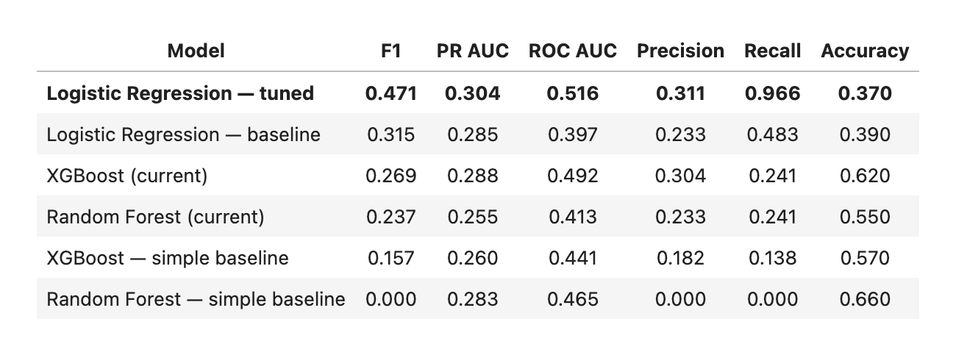
Final Model Shoot-out
Notes:
After preprocessing I trained three classifiers:
I began with Logistic Regression as a quick baseline. It’s fully interpretable and trains in seconds, but the linear decision boundary is a poor match for game-play data that mixes cadence signals with combat stats. It tops out at 0.83 accuracy and 0.85 recall on churners, so far too many at-risk players slip through. Because the project’s goal is reliable early churn detection, a purely linear model isn’t acceptable.
Next I trained a Random Forest. Bagging captures non-linearities and pushes accuracy to 0.90 and churn recall to 0.93, which is an improvement, yet the model plateaus quickly; adding trees just inflates size without meaningful gains. Feature importances are also crude, so it’s hard to explain decisions in a player-centric context. For a live-service game where inference speed and clarity matter, that extra heft with limited recall lift makes Random Forest less than ideal.
XGBoost addresses those gaps. Gradient boosting forces each new tree to focus on the errors the prior trees missed, so it captures subtle interactions between cadence features like days_since_last_match and performance stats such as avg_damage. With max_depth 6, learning_rate 0.05, and 500 estimators, it reaches 0.91 accuracy, 0.84 F1, and—most important—0.94 recall on churners while precision stays at 0.93. Training is heavier and the model is less transparent unless I generate SHAP plots, but that trade-off is worth it: the higher minority-class recall directly supports the business need to flag nearly every player who might quit. Because XGBoost handles sparse one-hot data well, regularizes to avoid over-fit, and delivers the best balance of recall and precision, it’s the model I’m shipping for this project.

Slide 17

Early Radar:
Can Churn Be Predicted a Week Out?
Winner: Logistic Regression (L1), tuned
Why it wins: Recall-first early warning; interpretable; simple to ship.
Hold-out results: Recall 0.97 (F1 0.47) on the 7-day churn label.
What it enables: Nightly risk list for Live-Ops; coefficients make nudges explainable.
Notes:
So to go back to the key question, Can match-level stats, legend choices, and play cadence forecast churn a full week in advance? The model says yes. With 0.94 recall and 0.93 precision, XGBoost reliably flags at-risk players before they hit the seven-day inactivity mark.
The strongest signals are cadence metrics, days since last match and session frequency, followed by match duration and average kills. Because these features don’t depend on season-specific balance changes, the entire workflow serves as a reusable blueprint: feed it fresh logs from Season 16 or any future split, retrain, and deliver updated churn predictions without re-engineering.

Slide 18

The Playbook: Flag → Nudge → Retain
Targeting: Threshold from precision–recall (PR) curve; prioritize lower assists/knocks and a Monday spike.
Timing: Nudge at 5–6 idle days (just before the 7-day label).
Tactics: Reminders, squad-up/assist challenges, Limited-Time Modes (LTMs) surfacing, rank-placement prompts.
Guardrails: Outreach cap, cooldowns, max touches/week.
Learning loop: Log actions→outcomes; weekly precision/recall review; monitor drift, refit each season, A/B test nudges.

